Slide 1

ONLINE RETAIL
The Story Behind the Transactions
What is really driving this online retailer's business?
by Naomi John, Soniya Khandare, & Stasha Pereira

Slide 2

ONE MILLION+ TRANSACTIONS.
ONE QUESTION.
525,461
Raw records — 2009–2010
541,910
Raw records — 2010–2011
More than 1 million transaction records across two years.
The Online Retail II dataset contains transaction-level information including invoice, product, quantity, price, date, customer and country.

Slide 3
From Raw Transactions to Valid Sales
2009–2010
2010–2011
What was filtered?
525,461
↓
duplicate removal
518,596
↓
sales filtering
504,730 valid sales
541,910
↓
duplicate removal
536,642
↓
sales filtering
524,878 valid sales
  Duplicate records
  Quantity ≤ 0
  Price ≤ 0
  Cancellation invoices (C)
  Adjustment invoices (A)
The notebook specifically identifies invoice prefixes C and A, including bad-debt adjustments, rather than blindly treating every negative value as a normal sale.

Slide 4
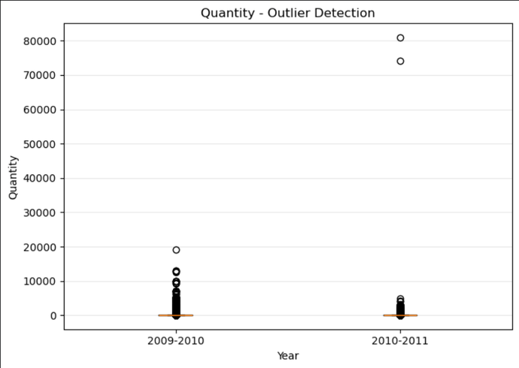
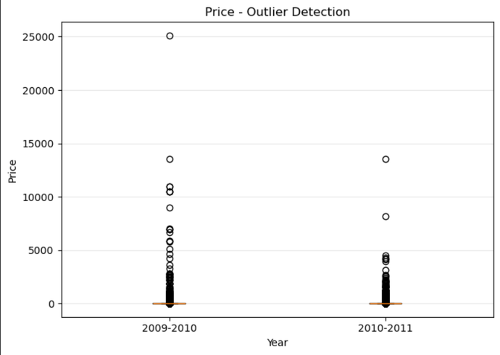
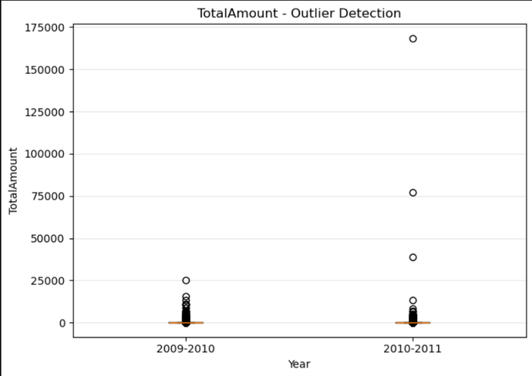

OUTLIER ≠ ERROR
Quantity
Price
Total Amount
IQR-based analysis identified unusual values, but unusual does not automatically mean incorrect.
Potential outliers detected:

Slide 5

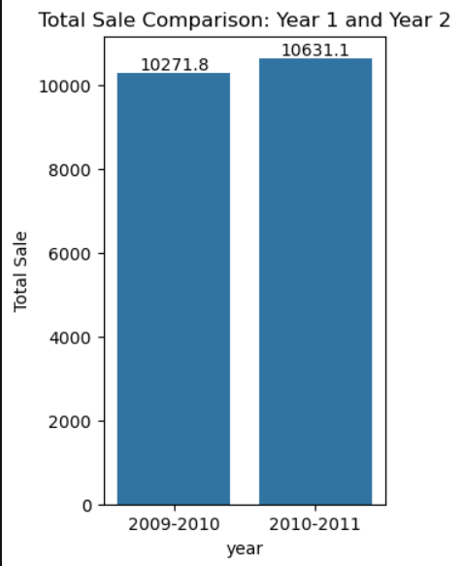
SO, WHAT HAPPENED TO THE BUSINESS?
REVENUE ↑VOLUME ↓
£10.27M → £10.63M +3.5% sales
5.81M → 5.57M −4.1% quantity
The notebook calculates total sales of £10,271,762.664 and £10,631,066.744 for the two periods, while total quantities are 5,812,947 and 5,572,420.

Slide 6
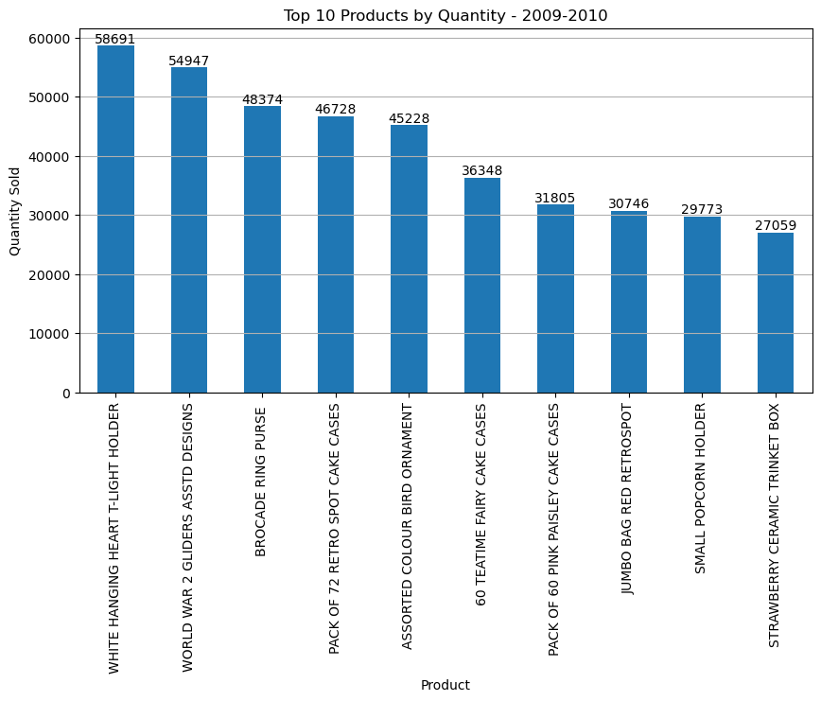
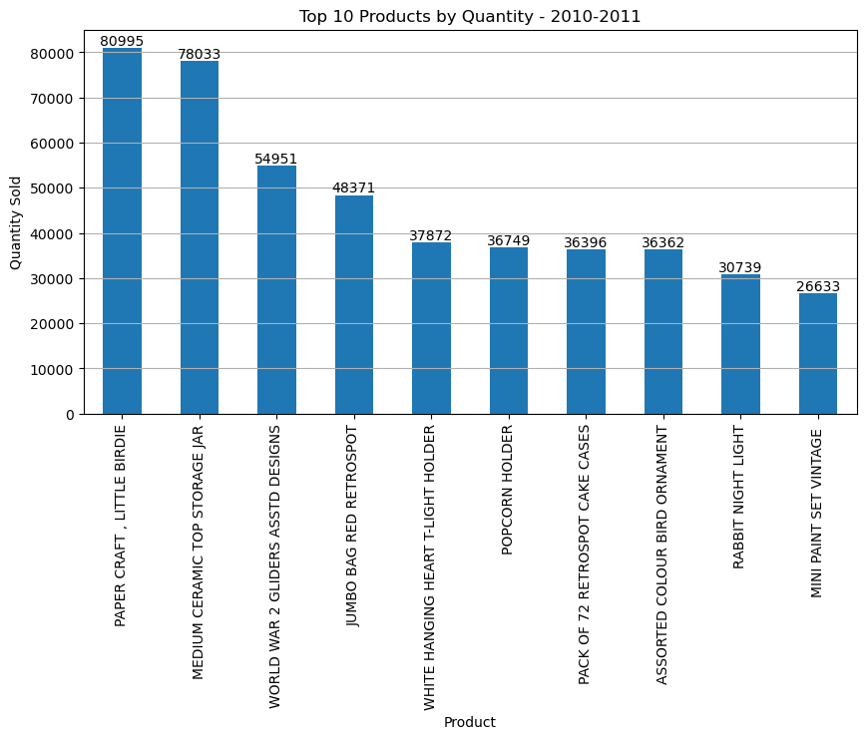
FEWER UNITS. MORE CONCENTRATION.
TOP-10 PRODUCT SHARE 7.05% → 8.38%
While total quantity declined, the top 10 products accounted for a larger share of the quantity sold.
The notebook calculates 409,699 units from the top 10 in 2009–10 and 467,101 in 2010–11.

Slide 7
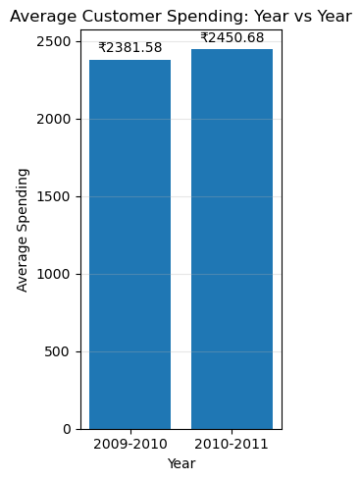
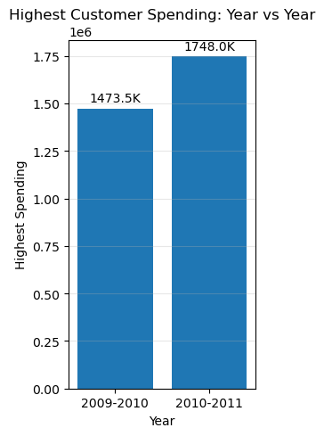
CUSTOMERS WERE SPENDING MORE
£2,381.58
2009–2010
↓
£2,450.68
2010–2011
+2.9%
£1.47M → £1.75M
The notebook reports those exact average and maximum customer-spending figures.

Slide 8
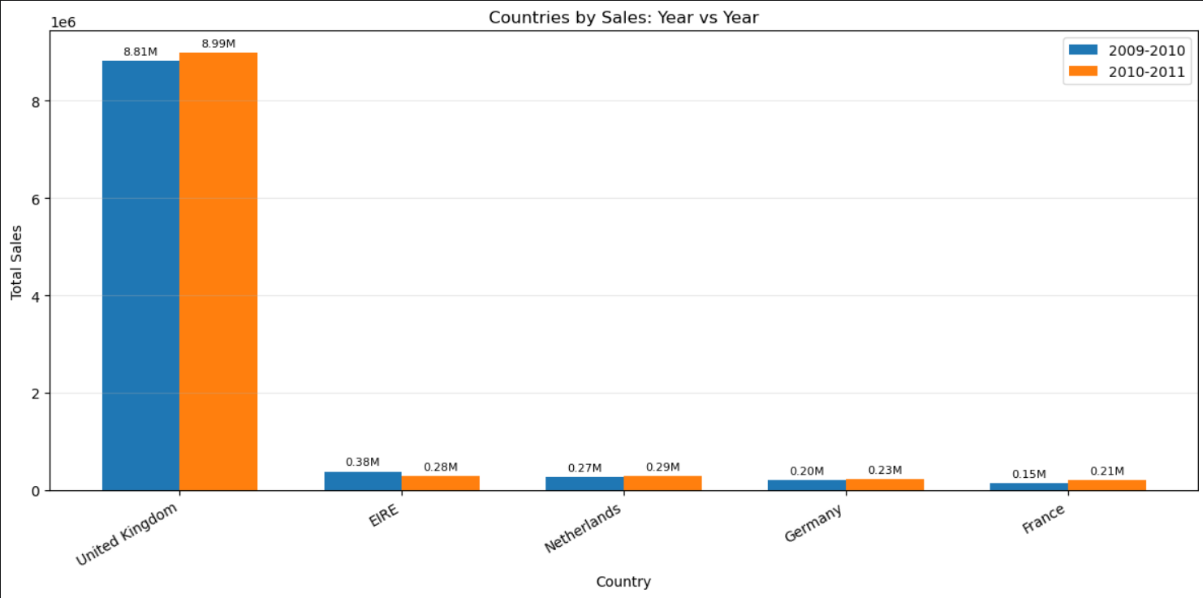
ONE MARKET DOMINATES
UK ≈ 85.8% OF SALES
The UK overwhelmingly dominates the retailer's sales, while the other leading markets contribute much smaller amounts.
The notebook's country totals show UK sales of £8.81M in 2009–10 and £8.99M in 2010–11.

Slide 9
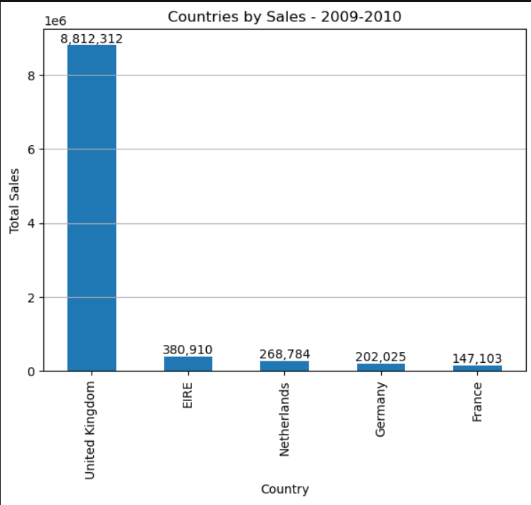
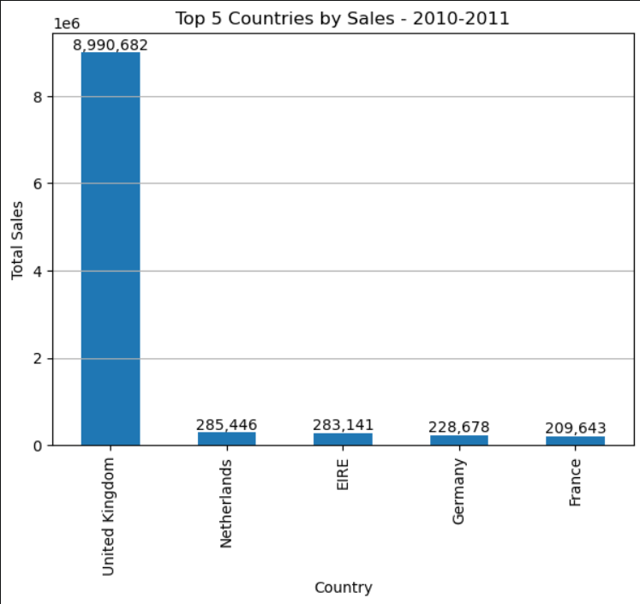
THE LEADING MARKETS SHIFT
COUNTRY PERFORMANCE ISN'T STATIC
WHAT CHANGED?
  UK remained #1
  Netherlands moved ahead of EIRE in 2010–2011
  France increased substantially
  Germany also increased

Slide 10
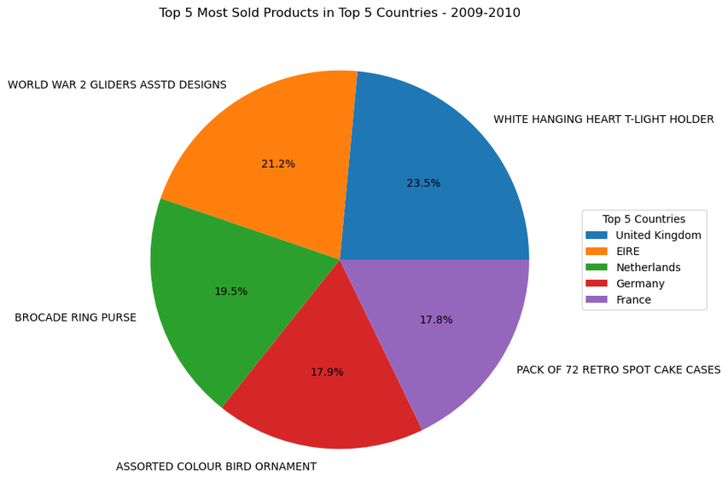
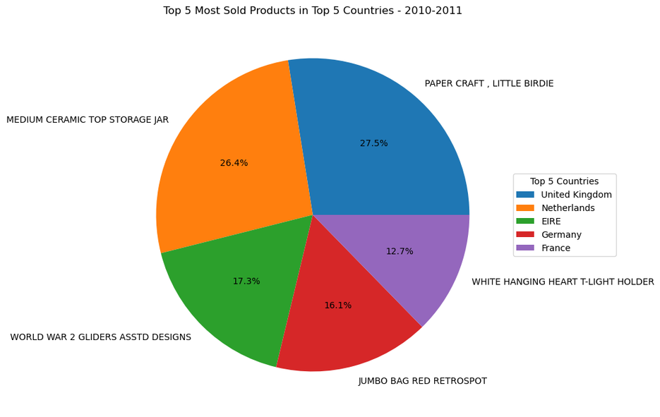
PRODUCT PREFERENCES DIFFER ACROSS MARKETS
The composition of the leading products changes between the two periods, showing that product demand is not completely static.
The notebook groups the top products across the selected top five countries.

Slide 11
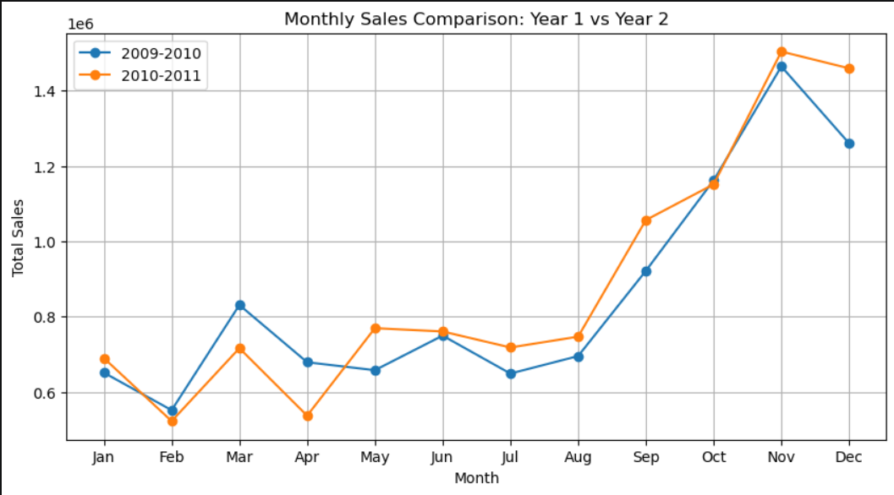
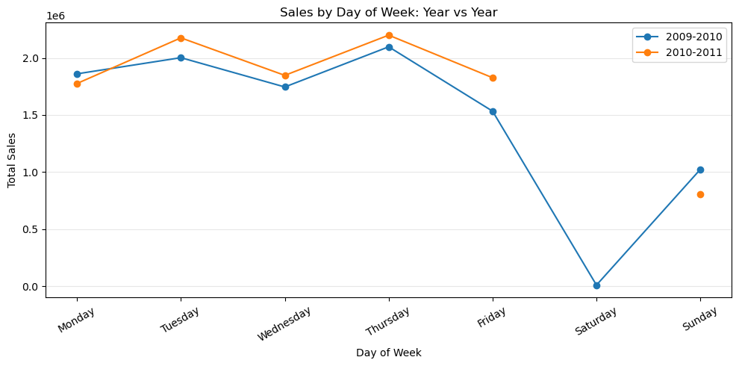
THE BUSINESS IS NOT STEADY THROUGHOUT THE YEAR
Monthly sales fluctuate substantially across the year, with both periods showing noticeable peaks and dips.

Slide 12
THE STORY BEHIND THE TRANSACTIONS
01 — REVENUE GREW
+3.5%
£10.27M → £10.63M
02 — VOLUME FELL
-4.1%
5.81M → 5.57M
03 — CUSTOMERS SPENT MORE
+2.9%
£2,381.58 → £2,450.68
04 — SALES REMAINED HIGHLY CONCENTRATED
≈85.8%
of sales came from the UK.
Revenue grew, even as transaction volume declined.
The analysis suggests that growth was not simply driven by selling more units — customer spending and product concentration also changed.

Slide 13
Here is where the story ends...
Thank You!

